Slide 1
Chapter 6 Information Sources and Signals
© Pearson Education Inc., Upper Saddle River, NJ. All rights reserved.
1
Notes:
1

Slide 2
PPTs are from lecture slides of
Computer Networks and Internets, 6th Ed. by Douglas E. Comer, Pearson

Slide 3
What Is Data Communications?
Broad field of study
Usually associated with the Physical Layer
Touches on
– Physics
– Mathematics
– Engineering
Includes
Transmission of signals
Encoding data
Modulation and multiplexing

Slide 4
6.3 Analog and Digital Signals
Data communications deals with two types of information:
analog
digital
An analog signal is characterized by a continuous mathematical function
A digital signal has a fixed set of valid levels
Figure 6.1 illustrates the concept
by showing examples of how the signals from an analog source and a digital source vary over time
© Pearson Education Inc., Upper Saddle River, NJ. All rights reserved.
4
Notes:
4

Slide 5
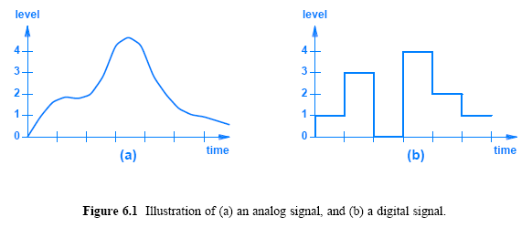
6.3 Analog and Digital Signals
© Pearson Education Inc., Upper Saddle River, NJ. All rights reserved.
5
Notes:
5

Slide 6
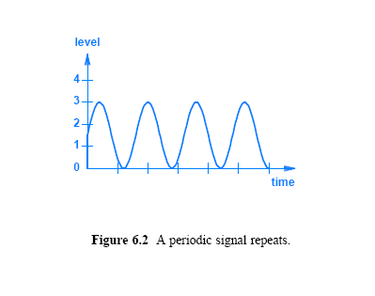
6.5 Sine Waves and Signal Characteristics
© Pearson Education Inc., Upper Saddle River, NJ. All rights reserved.
6
Notes:
6

Slide 7
6.5 Sine Waves and Signal Characteristics
Important characteristics of signals that relate to sine waves:
Frequency:
the number of oscillations per unit time (usually seconds)
Amplitude:
the difference between the maximum and minimum signal heights
Phase:
how far the start of the sine wave is shifted from a reference time
Wavelength:
the length of a cycle as a signal propagates across a medium
is determined by the speed with which a signal propagates
These characteristics can be expressed mathematically
Figure 6.3 illustrates the frequency, amplitude, and phase characteristics
© Pearson Education Inc., Upper Saddle River, NJ. All rights reserved.
7
Notes:
7

Slide 8
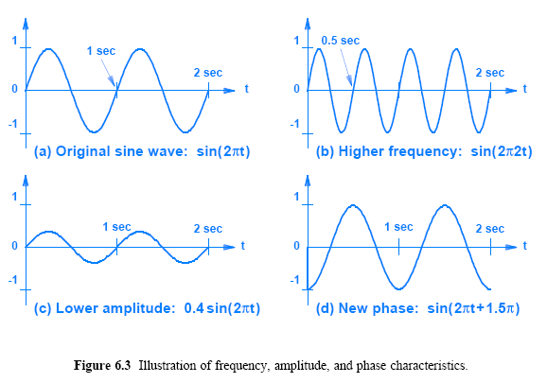
6.5 Sine Waves and Signal Characteristics
© Pearson Education Inc., Upper Saddle River, NJ. All rights reserved.
8
Notes:
8

Slide 9
6.5 Sine Waves and Signal Characteristics
The frequency can be calculated as the inverse of the time required for one cycle, which is known as the period
The example sine wave in Figure 6.3a has
a period T = 1 seconds
and a frequency of 1 / T or 1 Hertz
The example in Figure 6.3b has
a period of T = 0.5 seconds
its frequency is 2 Hertz
Both examples are considered extremely low frequencies
Typical communication systems use high frequencies
To clarify high frequencies, engineers express time in fractions of a second or express frequency in units such as megahertz (MHz)
Figure 6.4 lists time scales and common prefixes used with frequency
© Pearson Education Inc., Upper Saddle River, NJ. All rights reserved.
9
Notes:
9

Slide 10
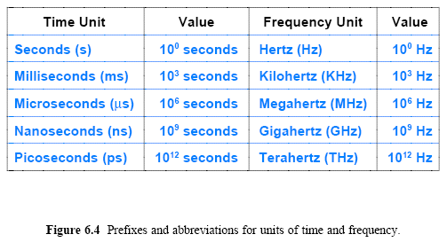
6.5 Sine Waves and Signal Characteristics
© Pearson Education Inc., Upper Saddle River, NJ. All rights reserved.
10
Notes:
10

Slide 11
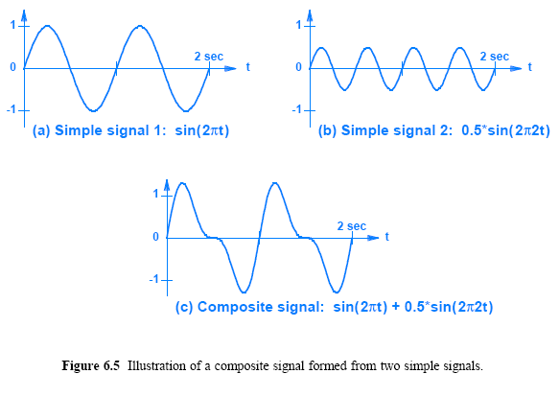
6.6 Composite Signals
© Pearson Education Inc., Upper Saddle River, NJ. All rights reserved.
11
Notes:
11

Slide 12
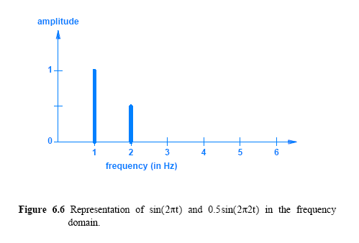
6.8 Time and Frequency Domain Representations
© Pearson Education Inc., Upper Saddle River, NJ. All rights reserved.
12
Notes:
12

Slide 13
6.9 Bandwidth of an Analog Signal
What is network bandwidth?
In networking and communication, the definition of bandwidth varies; here we describe analog bandwidth
We define the bandwidth of an analog signal to be the difference between the highest and lowest frequencies of the constituent parts (the highest and the lowest frequencies obtained by Fourier analysis)
Figure 6.7 shows a frequency domain plot with frequencies measured in Kilohertz (KHz)
Such frequencies are in the range audible to a human ear
In the figure, the bandwidth is the difference between the highest and lowest frequency (5 KHz - 1 KHz = 4 KHz)
© Pearson Education Inc., Upper Saddle River, NJ. All rights reserved.
13
Notes:
13

Slide 14
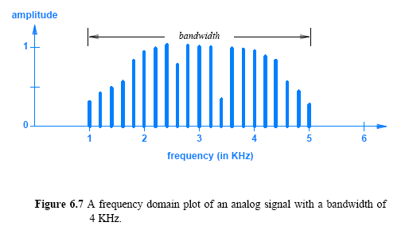
6.9 Bandwidth of an Analog Signal
© Pearson Education Inc., Upper Saddle River, NJ. All rights reserved.
14
Notes:
14

Slide 15
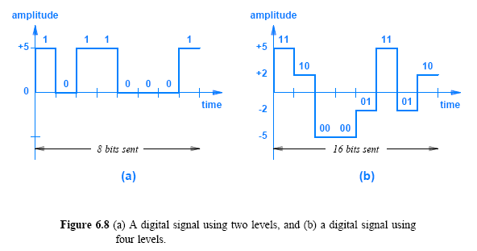
6.10 Digital Signals and Signal Levels
© Pearson Education Inc., Upper Saddle River, NJ. All rights reserved.
15
Notes:
15

Slide 16
6.11 Baud and Bits Per Second
As with signal levels, the hardware in a practical system places limits on how short the time can be
if the signal does not remain at a given level long enough, the receiving hardware will fail to detect it
The accepted measure of a communication system does not specify a length of time
how many times the signal can change per second, which is defined as the baud
for example, if a system requires the signal to remain at a given level for .001 seconds, we say that the system operates at 1000 baud
Both baud and number of signal levels control bit rate
© Pearson Education Inc., Upper Saddle River, NJ. All rights reserved.
16
Notes:
16

Slide 17

6.11 Baud and Bits Per Second
If a system with two signal levels operates at 1000 baud
the system can transfer exactly 1000 bits per second
If a system that operates at 1000 baud has four signal levels
the system can transfer 2000 bits per second (because four signal levels can represent two bits)
Equation 6.1 expresses the relationship between baud, signal levels, and bit rate
© Pearson Education Inc., Upper Saddle River, NJ. All rights reserved.
17
Notes:
17

Slide 18
6.13 The Bandwidth of a Digital Signal
What is the bandwidth of a digital signal?
If Fourier analysis is applied to a square wave?
A digital signal has infinite bandwidth
because Fourier analysis of a digital signal produces an infinite set of sine waves with frequencies that grow to infinity
© Pearson Education Inc., Upper Saddle River, NJ. All rights reserved.
18
Notes:
18

Slide 19
6.16 Manchester Encoding Used in Computer Networks
One particular standard for line coding is especially important for networks:
Manchester Encoding used with Ethernet
Detecting a transition in signal level is easier than measuring the signal level
This fact explains why Manchester Encoding uses transitions rather than levels to define bits
In Manchester Encoding, a 1 corresponds to a transition from negative voltage level to a positive voltage level
Correspondingly, a 0 corresponds to a transition from a positive voltage level to a negative level
The transitions occur in the “middle” of the time slot of a bit
Figure 6.13a illustrates the concept
© Pearson Education Inc., Upper Saddle River, NJ. All rights reserved.
19
Notes:
19

Slide 20
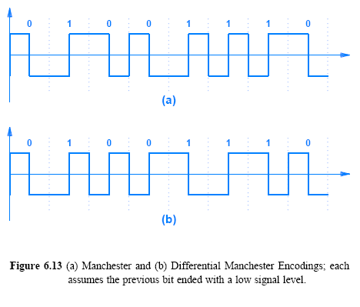
6.16 Manchester Encoding Used in Computer Networks
© Pearson Education Inc., Upper Saddle River, NJ. All rights reserved.
20
Notes:
20

Slide 21
6.17 Converting an Analog Signal to Digital
Many sources of information are analog
which means they must be converted to digital form for further processing (e.g., before they can be encrypted)
In PCM, the level of an analog signal is measured repeatedly at fixed time intervals and converted to digital form
The acronym PCM is ambiguous
because it can refer to the general idea or to a specific form of pulse code modulation used by the telephone system
Figure 6.14 illustrates the steps
© Pearson Education Inc., Upper Saddle River, NJ. All rights reserved.
21
Notes:
21

Slide 22
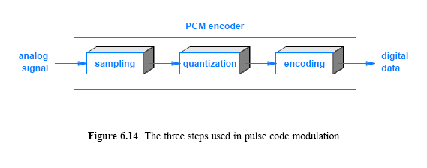
6.17 Converting an Analog Signal to Digital
© Pearson Education Inc., Upper Saddle River, NJ. All rights reserved.
22
Notes:
22

Slide 23
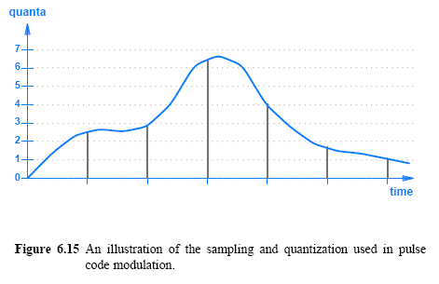
6.17 Converting an Analog Signal to Digital
© Pearson Education Inc., Upper Saddle River, NJ. All rights reserved.
23
Notes:
23

Slide 24
6.18 The Nyquist Theorem and Sampling Rate
An analog signal must be sampled in PCM or DM
How frequently should an analog signal be sampled?
Taking too few samples (undersampling) means that the digital values only give a crude approximation of the original signal
Taking too many samples (oversampling) means that more digital data will be generated, which uses extra bandwidth
A mathematician named Nyquist discovered the answer to the question of how much sampling is required:
where f_{max} is the highest frequency in the composite signal
Nyquist Theorem provides a practical solution to the problem:
sample a signal at least twice as fast as the highest frequency that must be preserved
© Pearson Education Inc., Upper Saddle River, NJ. All rights reserved.
24
Notes:
24

Slide 25
6.19 Nyquist Theorem and Telephone System Transmission
Consider the telephone system that was originally designed to transfer voice as an example
Measurements of human speech have shown that preserving frequencies between 0 - 4000 Hz provides acceptable audio quality
When converting a voice signal from analog to digital
the signal should be sampled at a rate of 8000 samples per second
The PCM standard used by the phone system quantifies each sample into an 8 bit value for quality
the range of input is divided into 256 possible levels so that each sample has a value between 0 and 255
The rate generated for a single telephone call is:
© Pearson Education Inc., Upper Saddle River, NJ. All rights reserved.
25
Notes:
25

Slide 26
Chapter 7 Transmission Media
© Pearson Education Inc., Upper Saddle River, NJ. All rights reserved.
26
Notes:
26

Slide 27
PPTs are from lecture slides of
Computer Networks and Internets, 6th Ed. by Douglas E. Comer, Pearson

Slide 28
7.1 Introduction
This chapter
continues the discussion of data communications
considers transmission media, including wired, wireless, and optical media
gives a taxonomy of media types
introduces basic concepts of electromagnetic propagation
explains how shielding can reduce or prevent interference and noise
explains the concept of capacity
© Pearson Education Inc., Upper Saddle River, NJ. All rights reserved.
28
Notes:
28

Slide 29
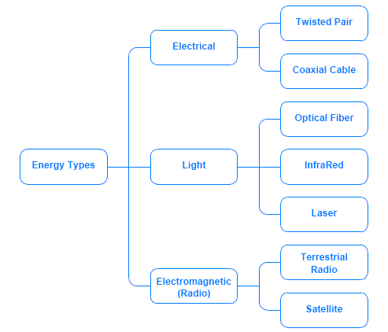
7.3 A Taxonomy by Forms of Energy
© Pearson Education Inc., Upper Saddle River, NJ. All rights reserved.
29
Notes:
29

Slide 30
7.5 Twisted Pair Copper Wiring
The third fact in the previous section explains the wiring used with communication systems
There are three forms of wiring that help reduce interference from electrical noise
Unshielded Twisted Pair (UTP)
also known as twisted pair wiring
Coaxial Cable
Shielded Twisted Pair (STP)
Twisting two wires makes them less susceptible to electrical noise than leaving them parallel as shown in Figure 7.2
© Pearson Education Inc., Upper Saddle River, NJ. All rights reserved.
30
Notes:
30

Slide 31
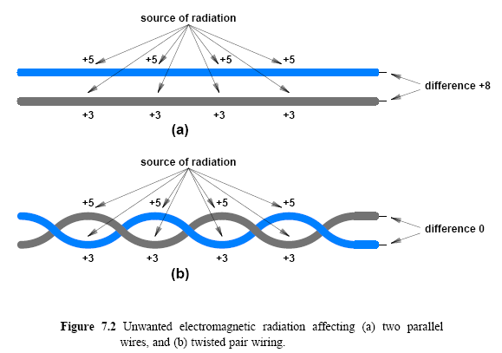
7.5 Twisted Pair Copper Wiring
© Pearson Education Inc., Upper Saddle River, NJ. All rights reserved.
31
Notes:
31

Slide 32
7.6 Shielding: Coaxial Cable and Shielded Twisted Pair
Forms of wiring are available that have extra metal shielding
The most familiar form is the wiring used for cable television
known as coaxial cable (coax)
the wiring has a thick metal shield formed from braided wires that completely surround a center (inner) wire that carries the signal
Figure 7.3 illustrates the concept
The shield in a coaxial cable forms a flexible cylinder around the inner wire
The barrier also prevents signals on the inner wire from radiating electromagnetic energy
A coaxial cable can be placed adjacent to sources of electrical noise and other cables, and can be used for high frequencies
© Pearson Education Inc., Upper Saddle River, NJ. All rights reserved.
32
Notes:
32

Slide 33
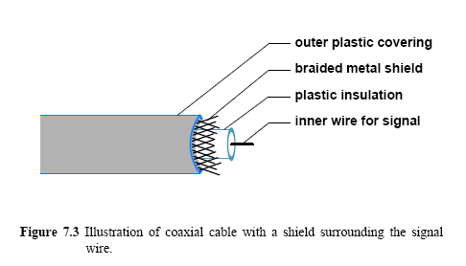
7.6 Shielding: Coaxial Cable and Shielded Twisted Pair
© Pearson Education Inc., Upper Saddle River, NJ. All rights reserved.
33
Notes:
33

Slide 34
7.6 Shielding: Coaxial Cable and Shielded Twisted Pair
Using braided wire instead of a solid metal shield keeps coaxial cable flexible
variation is known as shielded twisted pair (STP)
The cable has a thinner, more flexible metal shield surrounding one or more twisted pairs of wires
In most versions of STP cable, the shield consists of metal foil, similar to the aluminum foil used in a kitchen
© Pearson Education Inc., Upper Saddle River, NJ. All rights reserved.
34
Notes:
34

Slide 35
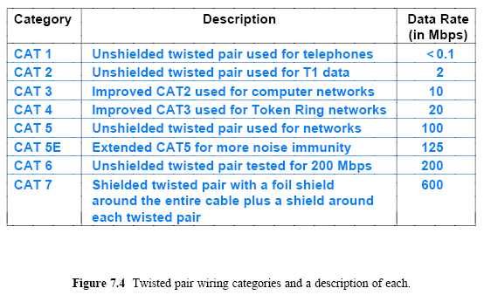
7.7 Categories of Twisted Pair Cable
© Pearson Education Inc., Upper Saddle River, NJ. All rights reserved.
35
Notes:
35

Slide 36
Media Using Light Energy
InfraRED transmission (short range and low data rate)
Point-to-point lasers (useful between buildings)
Optical fiber (high data rate and long distance)

Slide 37
7.8 Media Using Light Energy and Optical Fibers
The most important and widely used type is optical fiber
Each fiber consists of a thin strand of glass or transparent plastic encased in a plastic cover
An optical fiber is used for communication in a single direction
One end of the fiber connects to a laser or LED used to transmit light
The other end of the fiber connects to a photosensitive device used to detect incoming light
To provide two-way communication
two fibers are used; one to carry information in each direction
Transmission: LED or Injection Laser Diode (ILD)
Reception: photo-sensitive cell or photodiode
LEDs and photo-sensitive cells are used for short distances and slower bit rates common with multimode fiber;
© Pearson Education Inc., Upper Saddle River, NJ. All rights reserved.
37
Notes:
37

Slide 38
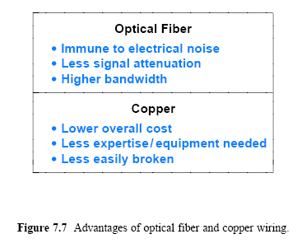
7.10 Optical Fiber Compared to Copper Wiring
© Pearson Education Inc., Upper Saddle River, NJ. All rights reserved.
38
Notes:
38

Slide 39
7.11 Infrared (IR) Communication Technologies
IR uses the same type of energy as a TV remote control:
a form of electromagnetic radiation that behaves like visible light but falls outside the range that is visible to a human eye
Like visible light, infrared disperses quickly
Infrared signals can reflect from a smooth, hard surface
IR commonly used to connect to a nearby peripheral
The wireless aspect of infrared can be attractive for laptop computers
© Pearson Education Inc., Upper Saddle River, NJ. All rights reserved.
39
Notes:
39

Slide 40
7.12 Point-to-Point Laser Communication
A pair of devices with a beam that follows the line-of-sight
IR is classified as providing point-to-point communication
Other point-to-point communication technologies also exist
One form of point-to-point communication uses a beam of coherent light produced by a laser
Laser communication follows line-of-sight, and requires a clear, unobstructed path between the communicating sites
© Pearson Education Inc., Upper Saddle River, NJ. All rights reserved.
40
Notes:
40

Slide 41
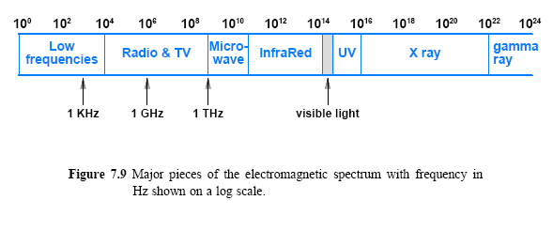
7.13 Electromagnetic (Radio) Communication
© Pearson Education Inc., Upper Saddle River, NJ. All rights reserved.
41
Notes:
41

Slide 42
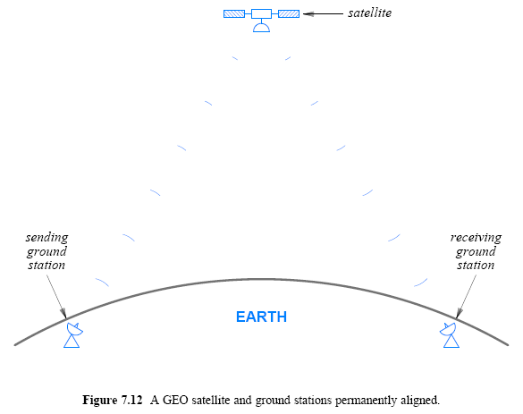
7.16 GEO Communication Satellites
© Pearson Education Inc., Upper Saddle River, NJ. All rights reserved.
42
Notes:
42

Slide 43

7.16 GEO Communication Satellites
The distance required for a geostationary orbit is 35,785 kilometers or 22,236 miles
which is approximately one tenth the distance to the moon
What does such a distance mean for communication?
consider a radio wave traveling to a GEO satellite and back
at the speed of light, 3¹⁰ meters per second, the trip takes:
A delay of approximately 0.2 seconds can be significant for some applications
For electronic transactions such as a stock exchange offering a limited set of bonds, delaying an offer by 0.2 seconds may mean the difference between a successful and unsuccessful offer
© Pearson Education Inc., Upper Saddle River, NJ. All rights reserved.
43
Notes:
43

Slide 44
7.19 Tradeoffs Among Media Types
The choice of medium is complex
Choice involves the evaluation of multiple factors, such as:
Cost
materials, installation, operation, and maintenance
Data rate
number of bits per second that can be sent
Delay
time required for signal propagation or processing
Affect on signal
attenuation and distortion
Environment
susceptibility to interference and electrical noise
Security
susceptibility to eavesdropping
© Pearson Education Inc., Upper Saddle River, NJ. All rights reserved.
44
Notes:
44

Slide 45
7.20 Measuring Transmission Media
The two most important measures of performance used to assess a transmission medium:
Propagation delay
the time required for a signal to traverse the medium
Channel capacity
the maximum data rate that the medium can support
Nyquist discovered a fundamental relationship between the bandwidth of a transmission system and its capacity to transfer data known as Nyquist Theorem
It provides a theoretical bound on the maximum rate at which data can be sent without considering the effect of noise
If a transmission system uses K possible signal levels and has a hardware bandwidth B, the maximum data rate in bits per second, D, is
© Pearson Education Inc., Upper Saddle River, NJ. All rights reserved.
45
Notes:
45

Slide 46
7.21 The Effect of Noise on Communication
Nyquist's Theorem provides an absolute maximum that cannot be achieved in practice
Nyquist’s Theorem gives us hope: using more signal levels can increase the data rate
a real system is subject to small amounts of electrical noise
Claude Shannon extended Nyquist's work to specify the maximum data rate that could be achieved over a transmission system that experiences noise (electrical noise in the universe limits the effective channel capacity of any practical communication system
The result, called Shannon's Theorem
C is the effective limit on the channel capacity in bits per second
B is the hardware bandwidth
S/N is the signal-to-noise ratio
© Pearson Education Inc., Upper Saddle River, NJ. All rights reserved.
46
Notes:
46

Slide 47

Assignment
<Assignment>
Show the rate at which two digital voice data are sent using the PCM in the same digital telephone system?
2. Find information on “wireshark”, and install in on your computer. What is the latest version of “wireshark”.
Send your results to me by email.
This assignment will be used to check attendance.

